Slide 1
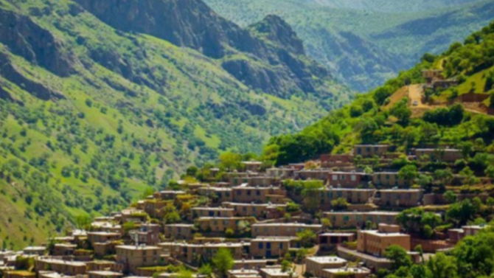

Kurdish
In FEIT Festival Of Languages
By Aso Mahmudi
https://feit-fol.github.io/

Slide 2
Kurdish
30-35 Millions of people identify as Kurd and refer to their language as Kurdish.
However, Kurdish is not a single standardized language. Kurdish is a dialect continuum.
Kurdish dialects are members of Iranic group of Indo-European language Family

Slide 3
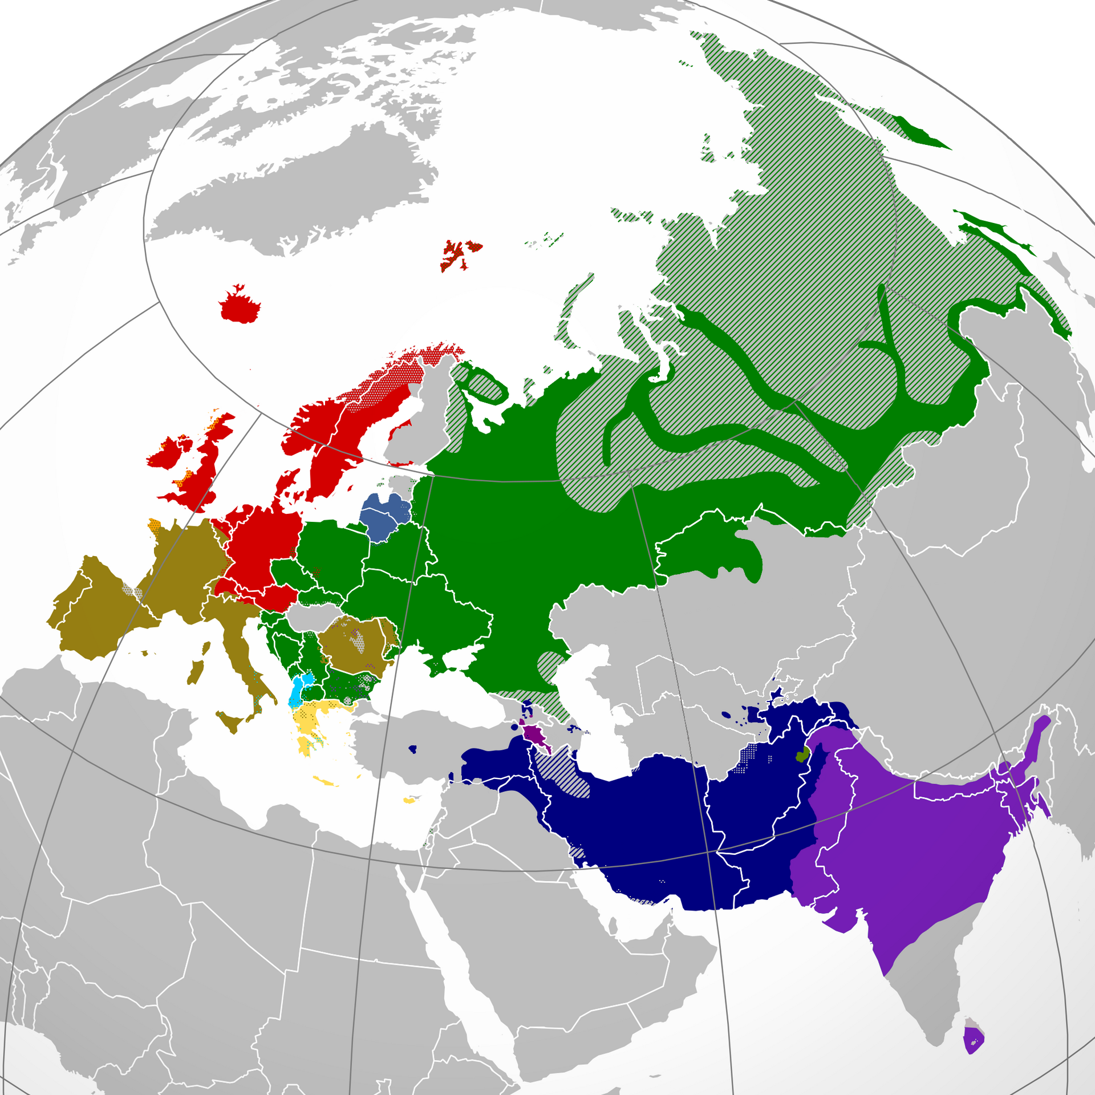
Indo-European languages
Iranic languages

Slide 4
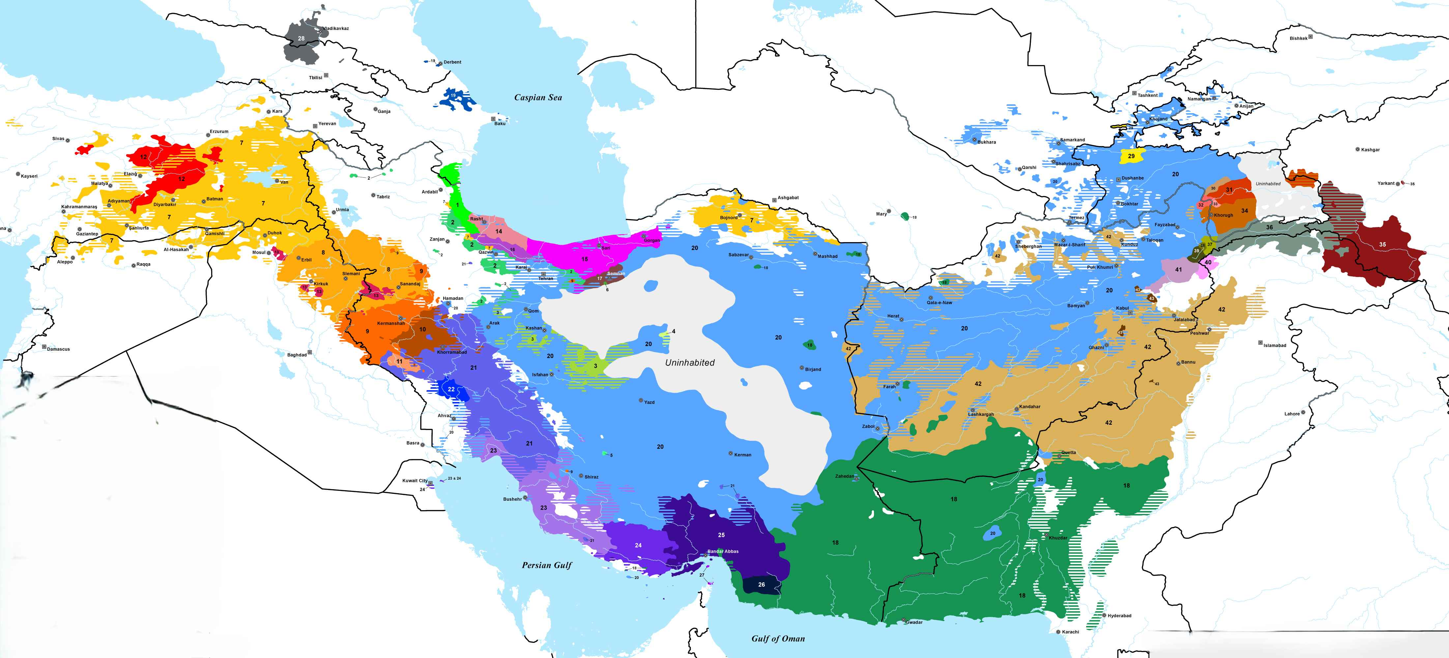
Turkish conquest: 1050 AD
Kurdic Group
Forcibly relocated ~ 1600 AD
Arab conquest: 650 AD

Slide 5
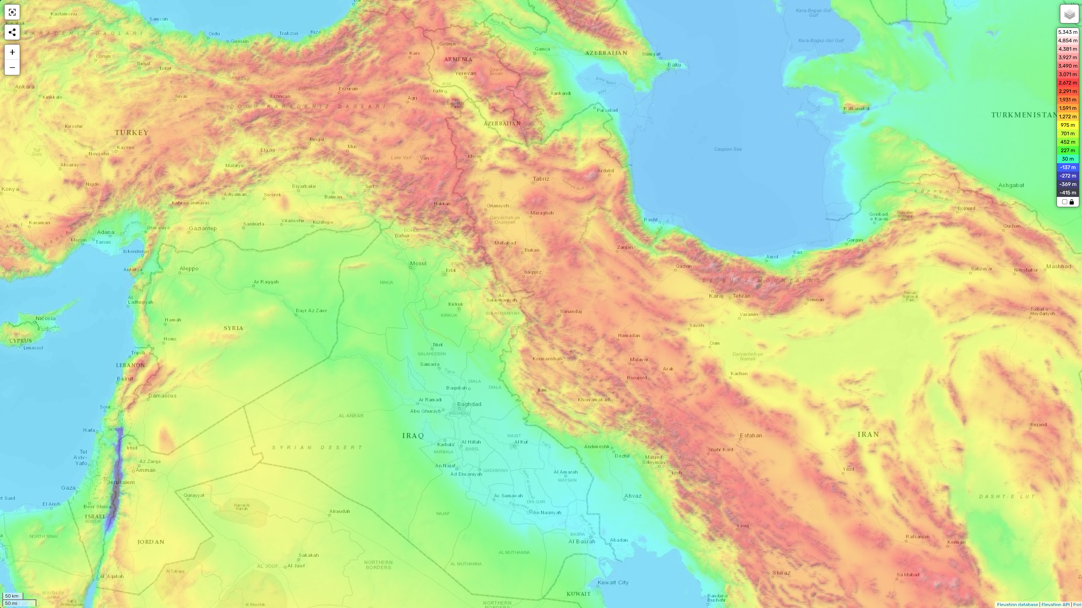
Kurdistan is predominantly a mountainous region.

Slide 6
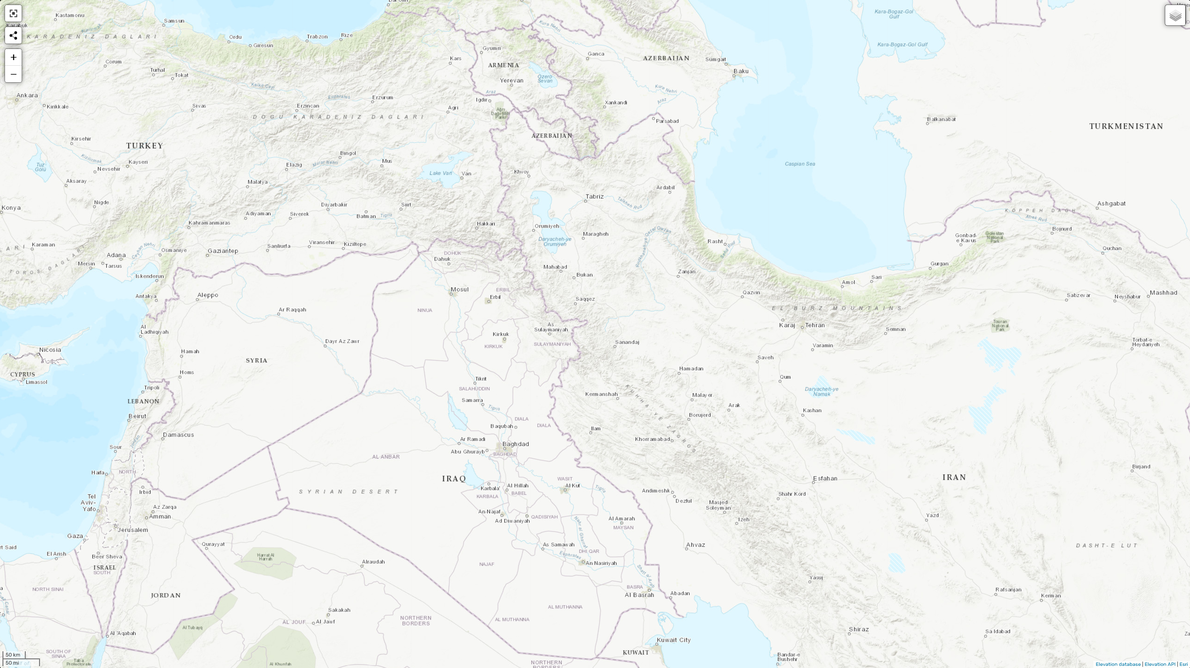
Zazaki
Northern
Northern
Central
Hawrami
Southern
Laki
Dialect Groups of Kurdish

Slide 7
Lexicon
English | Hawrami | Zazaki | Northern | Central | Laki | Southern | Farsi
three | yerê | hîrê | sê | sê | si | si | sê
milk | şot | şit | şîr | şîr | şîr | şîr | şîr
to eat | wardey | werdene | xwarin | xwardin | xwordin | xwardin | xorden
fine | weş | weş | xweş | xoş | xwiş | xweş | xoş
nine | no | new | neh | no | no | no | noh
brother | bira | bira | bira | bira | bira | bira | berader
eye | çem | çim | çav | çaw | çem | çew | çeşm
wind | ba | va | ba | ba | bad | bad | bad
Brother-in-law | zema | zama | zava | zawa | zama | zawa | damad
woman | jen | cen | jin | jin | jin | jin | zen
black | siyaw | siya | reş | reş | siya | siye | siyah
do (present stem) | -ker- | -ken- | -k- | -ke- | -ke- | -ke- | -kon-

Slide 8
Kurdish Across 4 Countries
Iraq
Taught in schools since the 1960s
Co-official with Arabic under the 2005 Constitution, especially in the Kurdistan Region
Used in government, media, and business
Hawrami is endangered; many villages were destroyed under Saddam Hussein
Not taught in schools
Since 2015, a BA program in Kurdish Language and Literature at one university
Turkey
Strictly banned in public use in the late 20th century
Language shift among younger generations toward Turkish
Since 2009, BA programs in Kurdish at a few universities
Since 2012, elective Kurdish courses in high schools, 2 hours per week
Syria
Strictly banned under the Assad regime
Official language in the Rojava Autonomous Administration since 2012
Recognized as a national language recently
Iran

Slide 9
Phonology

Slide 10
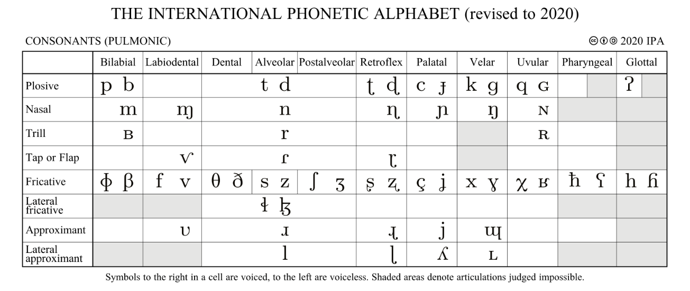
Consonants
29 consonants
w tʃ dʒ ɫ

Slide 11
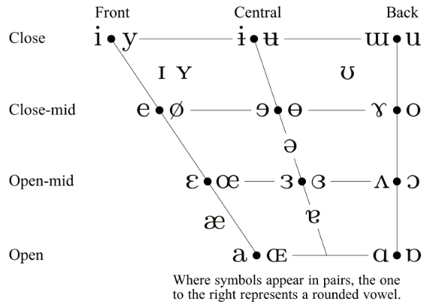
Vowels
8 vowels in all dialects
2 only in Hawrami
1 only in Southern and Laki

Slide 12
Morphology and Syntax

Slide 13
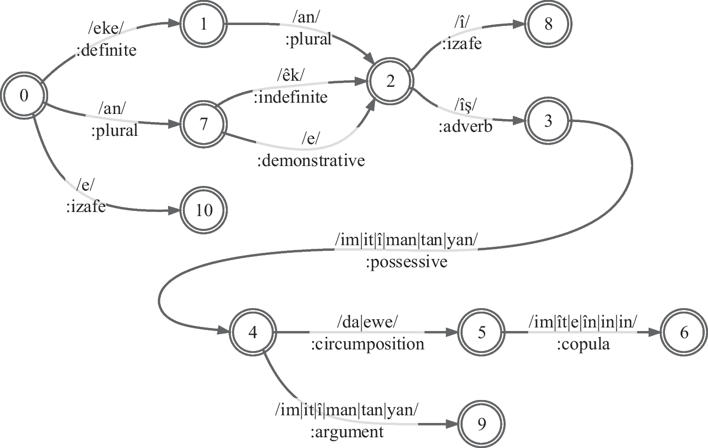
Nouns and Adjectives
Central Kurdish nouns can take up to 6 suffixes!
/le bax-eke-an=îş=man=da=in/
‘They are also in our gardens’.
We can generate 3033 inflected words for each noun!
And 9099 inflected words for each adjective!
Kurdish declension apps:
Central Kurdish: https://asosoft.github.io/generator/
Northern Kurdish: https://nlpkurdi.com/en/noun-adjective

Slide 14
Verbs
Verbs have 2 stems: present and past
Verbs are inflected in patterns to indicate tense, aspect, mood, and polarity
Each pattern uses one of the stems
The passive voice is formed morphologically by adding a suffix to the present stem.
In Northern Kurdish, however, the passive is formed analytically with the modal verb /hatin/ ‘come’.
Kurdish conjugator apps:
Central Kurdish: https://asosoft.github.io/generator/verb.html
Northern Kurdish: https://nlpkurdi.com/en

Slide 15
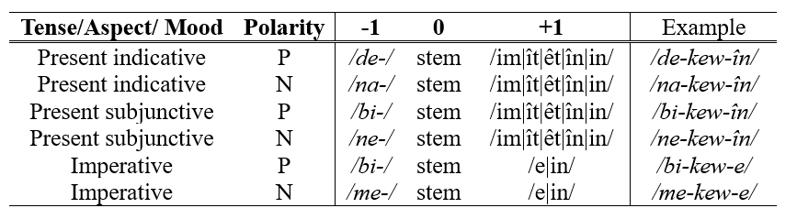
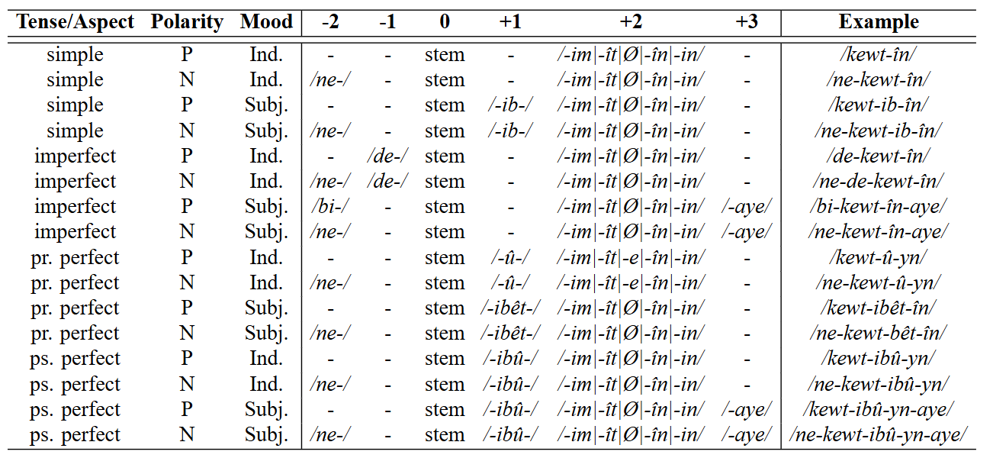
Verbal patterns
With Present stem
/-kew-/ ‘fall’
With Past stem
/-kewt-/ ‘fell’

Slide 16
Pronouns
Direct | 1S | 2S | 3S (near) | 3S (far) | 1P | 2P | 3P (near) | 3P (far)
Northern | ez | tu | ev | ew | em | hûn | ev | ew
Central | min | to | em | ew | ême | êwe | eman | ewan
Southern | mi | to | î | awe | îme | îwe | yane | awane
Laki | mi | to | î | ow | îme | home | yane | ewane
Hawrami | min | to | êḍ|êḍe | ad|ade | ême | şime | êḍê | aḍê
Zazaki | ez | ti | no|na | o|a | ma | şima | nê | ê
Farsi | man | to | în | ûn | ma | şoma | îna | ûna
Oblique | 1S | 2S | 3S (near) | 3S (far) | 1P | 2P | 3P (near) | 3P (far)
Northern | min | te | vî|vê | wî|wê | me | we | van | wan
Hawrami | min | to | êḍî|êḍê | adî|adê | ême | şime | êḍîş | aḍîşa
Zazaki | mi | to | ney|nay | ey|ay | ma | şima | nînan | înan

Slide 17
Adposition
Preposition
/be/ ‘to’
/le/ ‘at, from’
/bê/ ‘without’
/wekû/ ‘like’
Circumposition (2-part prepositions)
/le ...‑ewe/ ‘from’
/le ...‑da/ ‘in’
/be ...‑ewe/ ‘with’
/be ...‑da/ ‘through’
/legeɫ ...‑da/ ‘together with’
/bo ...‑ewe/ ‘toward’

Slide 18
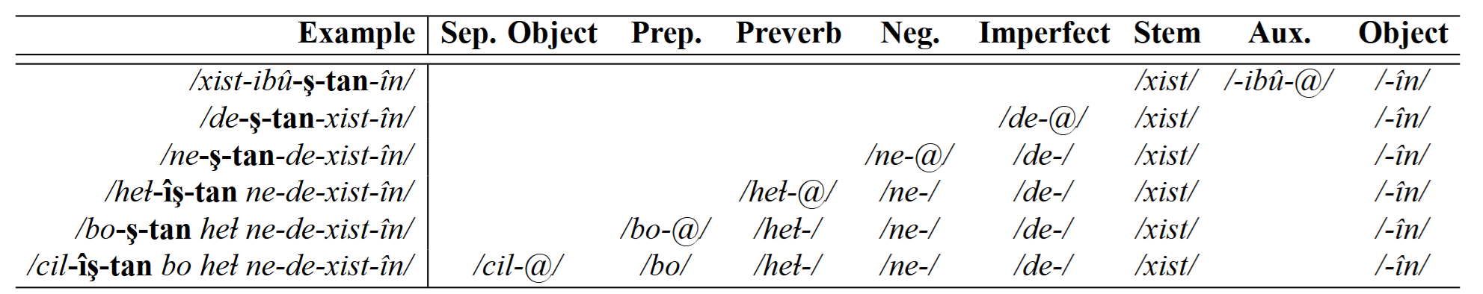
Word Order
Subject + Object + Verb + Indirect Object
In Central and Hawrami, enclitics displace with availability of components:

Slide 19
Morpho-syntactic Features
Gender
In Northern, Hawrami, and Zaza, nouns are classified as either Feminine or Masculine.
Case
In Northern, Hawrami, and Zaza there is an oblique (objective) case
Examples from Northern Kurdish:
Feminine: ez dar-ê di-bîn-im
Masculine: ez ser-î di-bîn-im
Izafe (a special structure in Iranic languages)
In Central Kurdish
ser=î Aso (head of Aso, Aso’s head)
ser=î zil (big head)
ser=e zil-eke (the big head)
In Northern Kurdish
Feminine: dar=a Aso-î, dar=a berz
Masculine: ser=ê Aso-î, ser=ê berz

Slide 20
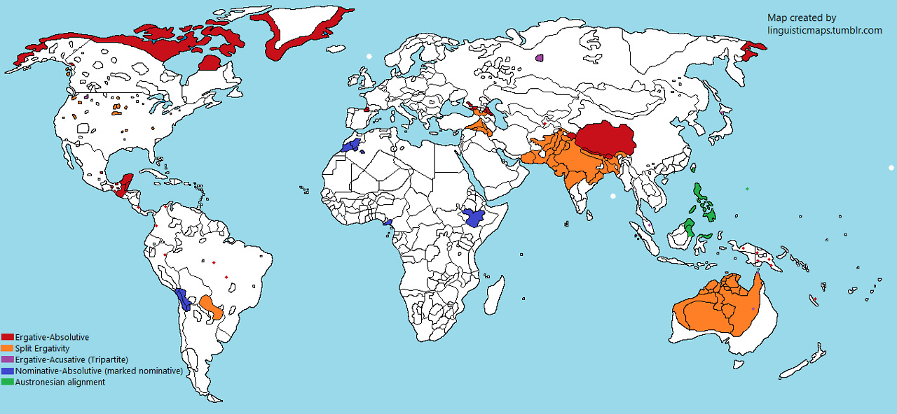
Split Ergativity
 | Present | Past
Intransitive | we go | we went
transitive | we see him | we saw him => us saw he
Ergativity is a rare feature!
Northern Kurdish | Present | Past
Intransitive | em di-ç-in | em çû-n
transitive | em wî di-bîn-in | em wî dît-in=> me ew dît-0
Central Kurdish | Present | Past
Intransitive | ême de-ç-în | ême çû-în
transitive | ême ew de-bîn-în | ême ew dît-în => ême ew-man dît-0 dît-man-0

Slide 21
Typology
Feature | Hawrami | Zazaki | Northern | Central | Laki | Southern | Farsi
Split Ergativity | ✅ | ✅ | ✅ | ✅ | ✅ | ❌ | ❌
Morphological Passive | ✅ | ✅ | ❌ | ✅ | ✅ | ✅ | ❌
Gender | ✅ | ✅ | ✅ | ❌ | ❌ | ❌ | ❌
Oblique Case | ✅ | ✅ | ✅ | ❌ | ❌ | ❌ | ❌
Agreement suffixes with present verbs | û | î | o mê | dê | a | a | ê/a | o/a ê | ê | ê | im | î | e in | in | in | im | ît | êt în | in | in | im | în | ê îmin | înan | in | im | îd | êd îmin | în | in | em | î | ê îm | îd | en
Possessive suffixes | im | it | ş ma | ta | şa | ❌ | ❌ | im | it | î man | tan | yan | im | it | î man | tan | yan | im | id | î man | tan | yan | em | êt | êş êman | êtan | êşan
Past Participle | -e/-ê | -î | -î | -uw | -e | -e | -ê
Progressive suffix | me- | ❌ | di- | de- | me- | ❌ | mi-

Slide 22
Current Writing Systems of Kurdish
Latin-based Alphabet
Used in Turkey and Syria
Writes Northern Kurdish and Zazaki
Based on 26 Latin letters + 5 letters: ş, ç, î, û, ê
Arabic-based Alphabet
Used in Iraq and Iran
Standardized in 1920s to 1970s
Not an abjad, all vowels are written!
Adds 5 letters: ڵ, ۆ, ێ, ڕ, ڤ
Shares letters with Persian: پ, چ, ژ, گ
Removes Arabic-specific letters: ث, ذ, ص, ض, ط, ظ
Standardized in 1930s

Slide 23
Technology (Mostly developed for Northern & Central)
Machine translation (CK and NK):
Google, Bing, DeepL
LLMs (CK and NK):
Gemini, ChatGPT
Spell-checker
spell.kurdinus.com/en/ (CK, Rule-based)
nlpkurdi.com/ku/spell-checker (NK, Rule-based)
halachn.pkrd.ai/ (CK, Neural Model)
Speech Recognition:
t.me/AsosSoftSTT_bot/ (CK)
jiridastkrd.com/ (CK, NK)
Text-to-Speech:
t.me/AsosSoftSTT_bot/ (CK)
nlpkurdi.com/ku/text-to-speech (NK)

Slide 24
Digital Resources
Wikipedia:
Central ckb.wikipedia.org/
Northern: ku.wikipedia.org/
Zazaki: dqi.wikipedia.org/
Dictionaries: https://lex.vejin.net/en
Literature: https://books.vejin.net/en
Introduction to Kurdish on YouTube
https://www.youtube.com/watch?v=mQwEreh1Alk
https://www.youtube.com/watch?v=5Z9GfKVi_X0
https://www.youtube.com/watch?v=UFbUp8916_o

Slide 25
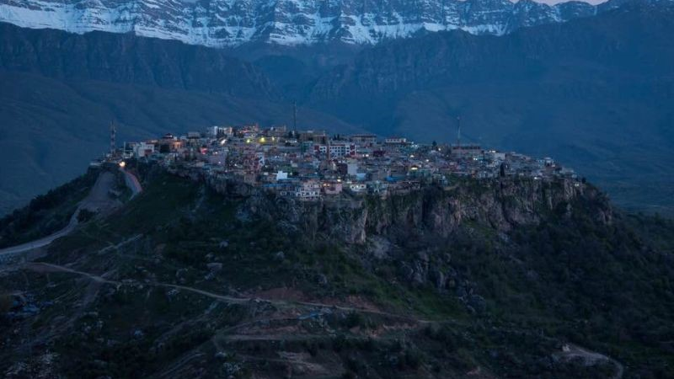
Thank you

